Slide 1
Game Theory and Nash Equilibrium Lecture 8
John P. Baugh, Ph.D. University of Michigan - Dearborn

Slide 2
Introduction
In this chapter, we look at an area of applied mathematics called Game Theory
Game Theory is heavily related to Decision Theory, which we discussed before
Game Theory is largely concerned with how both cooperative and adversarial entities make decisions
We will discuss Nash Equilibrium, which is related to how players in non-cooperative games make decisions while making correct assumptions about the other player’s moves

Slide 3
Lecture 8 Contents
Concepts and Terminology
Two Person, Zero Sum Games with Pure Strategy
Mixed Strategies and Mini-Max Theorem
Nash Equilibria in Non-Zero Sum Games

Slide 4
Concepts and Terminology

Slide 5
Concepts and Terminology
Strategy refers to the choices a player makes in light of the choices of other players
There are many classifications of games
New designations are still being defined all the time
We will consider some traditional classifications of game
Random and Non-random games
Perfect knowledge and Non-perfect knowledge games
N-Player games
Zero sum and non-zero sum games

Slide 6
Random vs Non-Random
Random games
Involve some unpredictable aspect
Examples of random determination
Order of a deck of cards
Result of a dice throw
Result of a spinner
Game examples
Poker
Monopoly
Life
Non-Random games
Pure strategy games
Examples
Chess, checkers, Stratego

Slide 7
Perfect Knowledge vs Non-Perfect Knowledge
Perfect knowledge games
All parts of the game are known to all players
Examples: chess, checkers, Monopoly
Non-Perfect knowledge games
Involve some hidden aspect of the game
Examples: Stratego, Poker, Battleship

Slide 8
n-Player Games
The number of players in a game is usually self-evident
1 player games
Angry Birds, Mazes, Puzzles
2 player games
Chess, checkers, Stratego
4 player games
Cribbage, Bridge
Theoretically arbitrary number of players
Poker, Monopoly

Slide 9
Zero-sum vs Non-zero-sum
Zero sum games
The value of the game never increases
E.g., in poker the amount of money at the start of the game is equal to the total at the end (the money will have likely changed hands and moved, but does not change the overall amount in the game)
E.g., In chess, the number of pieces never increases (it does however, decrease!)
Non-zero sum games
The value of the game increases
E.g., In Monopoly, the players get an additional $200 every time they pass GO, which is not taken from other players

Slide 10
Two-Person, Zero Sum Games
“I cannot waste time in these classes and these books, memorizing the weak assumptions of lesser mortals.” – John Nash

Slide 11
Two Person, Zero Sum Games with Pure Strategies
The simplest type of games are two-person, zero-sum games
So, n-player game with n = 2, and
Zero-sum, so the overall value in the game doesn’t increase
Consider a game where each player makes a single decision to determine the outcome
And the decision is made simultaneously by both players
E.g., Rock-Paper-Scissors
Consider that $1 is the prize for winning a round
This $1 remains during the game, and doesn’t increase or come from an arbitrary origin
If you win, the other player pays you $1
If you lose, you pay the other player $1
If you tie, $0 changes hands

Slide 12
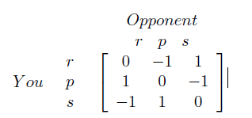
Two Person, Zero Sum Games with Pure Strategies
Consider our rock-paper-scissors example
We can model this with a matrix
Columns indicate the choices of the opponent
Rows indicate your choices
The payoffs are the values in the Matrix
They are relative to you alone (the player who wants to maximize the rows)
When you win $1, your opponent loses exactly $1
Studies have shown, if you play the game with people you know, multiple times, the game usually results in a tie more often than people who don’t know one another well

Slide 13
Two Person, Zero Sum Games with Pure Strategies
A variant to add more variety is Rock-paper-scissors-lizard-Spock

Slide 14
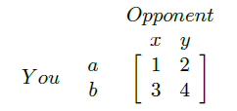
Example 1: Clear Strategy
Remember, strategy means the choice you make in light of the choices of the other player(s)
In some cases, the strategy is very clear
In the following game, represented by a matrix, you make money regardless of the choices
But, you want to make as much as possible, and your opponent simultaneously wants to lose as little as possible
So, in the given game, you clearly choose b, and your opponent will clearly choose x, so (b, x) is the equilibrium strategy
This means that the pair (b,x) is stable, which in turn means if either player changes from the equilibrium, the result will be worse for that player

Slide 15
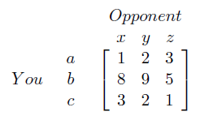
Example 2
Your choice is clear: pick b, since all those values are maximal in the board
Your opponent’s choice is not so clear
No column is really best to minimize their loss
However, if the opponent assumes you make a rational choice, then they will pick z
In this case, the Nash equilibrium is (b, z) and the value of the game is 5
Nash equilibrium means that both players make rational choices, in light of the other player’s choice(s)

Slide 16
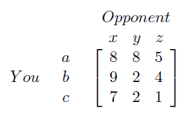
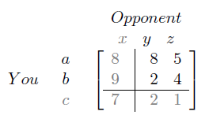
Example 3
This time it’s not clear what’s best for either you or your opponent
However, it’s quickly apparent you do not want to play c since these are all the worst
Also apparent is that your opponent will not play x, since that column has the maximal values, and they don’t want you to have those
Therefore, you can eliminate row c, and column x, reducing the number of choices
Of the remaining choices, you would pick a
Since your opponent knows you will favor a, he/she will pick z to reduce the amount you get when you pick a

Slide 17
Dominance
There can be more than one equilibrium point in two-person, zero-sum games
When this occurs, the value of the equilibrium points is equal
The technique used so far is dominance
A row (or column) of matrix A is said to dominate another row (or column) B, if all values of A are greater (less) than all values of B
It is intuitively clear that if a row is dominated it is a poor choice for you
And if a column is dominated, it’s a poor choice for your opponent
We used dominant strategies (choices) and eliminated them to reduce our choices
Often, we can simplify the matrix and reach an equilibrium strategy

Slide 18
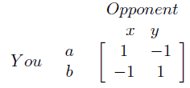
Mixed Strategies
Not all games have a strategy that can be determined by domination
The Rock-Paper-Scissors game discussed earlier is one such example
The example on this slide is another
No row or column dominates another
If your choice is known by your opponent, your opponent will always win
In other words, if you choose the same strategy repeatedly, your opponent will quickly choose the opposite strategy and would always win
If you choose either strategy A or B with 50% probability, you will win half the time, and lose half the time
This is called a mixed strategy
Thus, it is when you use a more random method to select a strategy (choice)
Nash showed that all games have mixed strategy equilibrium points

Slide 19
Mixed Strategies and Mini-Max Theorem
“Classes will dull your mind, destroy the potential for authentic creativity.” – John Nash

Slide 20
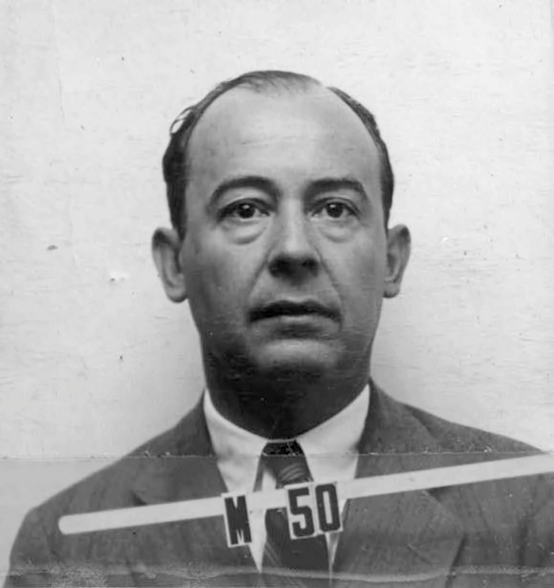

Mixed Strategies and Mini-Max
With equilibrium strategies (choices) we tried to maximize our payoff while our opponent tried to minimize them
Therefore, equilibrium strategies can be characterized as mini-max points
John von Neumann
Proved that in all zero-sum, two-person games, there is a mixed strategy that produces an equilibrium point
Theorem 2.3.1 (Elenbogen/Baugh)
Let X and Y be column vector mixed strategies for two players in a game defined by the matrix A. Then the value of the game, v can be determined by

Slide 21
Payoff/Value and Risk Aversion
A mixed strategy payoff (value) is one that is expected on average when the game is played a large number of times
It says nothing about the short run
As a note, a trait of some people to choose a smaller guaranteed amount over a chance at a larger amount is called risk aversion

Slide 22
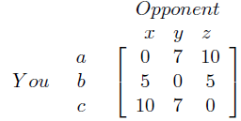

Example 1: Mixed Strategy Payoff
Consider the game matrix on this slide
It’s easily seen that no row or column seems to dominate or be dominated, so the game can’t be reduced
If the mixed strategy for the opponent is to choose x half the time, and z the other half, then the value of the game is:
So, it comes down to the sum of the probabilities as a scalar multiplied by the columns

Slide 23
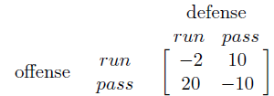
Example 2: Mixed Strategy
Assume you are making a simple AI for a computer football game
When the user is on offense, they have options to run or pass
Likewise, the computer can set up a run or pass defense
The payoff therefore is the expected number of yards gained or lost
First, it’s clear that the offense can’t always run or always pass
This would allow the defense to anticipate the play and choose a strategy that results in the offense’s losses
So, we will need the mini-max theorem!

Slide 24
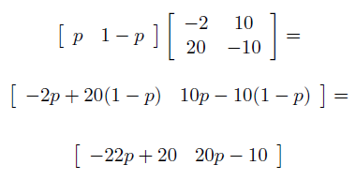
Example 2: Mixed Strategy
First, the overall strategy can be seen using the mini-max theorem:
First, let’s consider the offensive strategy
We want to find a p to maximize the minimum column
We know the opponent picks the minimum column, and we want to choose the maximum in that column

Slide 25


Example 2: Mixed Strategy
We take the values from the 1x2 matrix we found, and set them equal to one another
This is because we want to maximize the value in face of our opponent’s defense by choosing the minimum column
So, the offense should pick run with a probability of 5/7
So, the offense picks pass with a probability of 2/7
Thus, the value of the game is found by plugging in the value for p in either column:
v = -22p + 20 = -22(5/7) + 20 = $4\frac{2}{7}$

Slide 26


Example 2: Mixed Strategy
We can try solving for the opponent’s mixed strategy (defense) and see if it agrees with our overall game value calculated previously
Defense seeks to minimize the value against all choice of rows by the offense, so defense sets them equal:
10 – 12q = 30q – 10 or 42q = 20, so q = 10/21
So, defense’s mixed strategy should choose the run defense with probability 10/21, and pass defense with probability 11/21
Let’s compute our game value v to see if it agrees with the previous value
v = 10 – 12q = 10 – 12(10/21) = 10 – (40/7) = $4\frac{2}{7}$

Slide 27
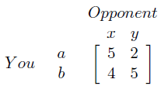
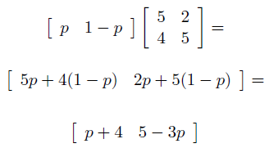
Example 3: Mixed Strategy
Given the game matrix, find the value of the game and probabilities using the mini-max theorem
For You, we want to find a p to maximize the following:

Slide 28


Example 3: Mixed Strategies
So we get:
So we should pick a with probability 1/4 and pick b with probability 3/4
What about our game value?
v = p + 4 $=5−3\left(\frac{1}{4}\right)$ = $4\frac{1}{4}$
What about the opponent’s mixed strategy?

Slide 29

Class Exercise: Mixed Strategy
Class Exercise: Find the opponent’s mixed strategy (probs and game value, v)

Slide 30


Class Exercise: Mixed Strategy
Solution for the opponent’s mixed strategy:
So:
2 + 3q = 5 – q → 4q = 3, so q = 3/4
So, opponent should choose x with probability 3/4 and y with probability ¼
What about the overall game value? Plug in numbers and see if we get the same value, that is, $4\frac{1}{4}$
v = 2 + 3q = 2 + 3(3/4) = $4\frac{1}{4}$

Slide 31
Nash Equilibria in Zero-Sum Games
See section 2.4 for two-person, zero-sum games

Slide 32
Questions?
Questions?
Comments?
Remarks?

